Slide 1
MOBILE APPLICATION DEVELOPMENT

Slide 2
Application Development
  Application development is the process of creating a computer program or a set of programs to perform the different tasks that a business requires.
  --OR--
  Application development is the process of designing, building, and implementing software applications.

Slide 3
What is Software Development Life Cycle
A Software development lifecycle is an abstract representation of various processes used in the development of any software.
Different lifecycle models include (some examples):
  Water fall Model
  Spiral Model
  Agile Model
  Prototyping Model
  Iterative Model

Slide 4
Why Different Software Development Life Cycle?
There is not much difference between developing applications for desktops, Web or for mobile devices, the basic steps are always the same.
The development steps or the activities may vary in each and every model but all the models will include planning, requirement analysis and design. E.g.
  The Waterfall Model emphasizes more on step-by-step process
  The Spiral Model emphasizes on risk assessment
  The prototyping model takes an incremental approach in each and every phase of development process.

Slide 5
Mobile Application Development
There is no much difference between building an application for Desktops, Web or for Mobile Devices
Although, modifications are required to match the nature of the mobile application
  It is not possible to simply transfer the models of the traditional software development to mobile application development
Say: Mobile applications are developed faster so they must have a faster lifecycle than traditional application

Slide 6
Need for Mobile Application Development Life Cycle
In any application development life cycle Productivity Factors are common
    Characteristics considered for developing all software applications which are called productivity factors such as Functionality requirements, Reliability requirements, Usability requirements, Efficiency requirements, Maintainability requirements and Portability requirements are common.
In mobile application other then productivity factors certain characteristics inherent to system and mobile are required.
  Limited Energy
  Graphical Interface
  User Interface
  Change of context
  Limited Performance
  Reduced memory
  Connectivity
  Constant Interruption of Activities
  Response Time
  Portability
  Processing
  Application Type (native, web or hybrid)

Slide 7
Challenges in Mobile Application Development
  Fragmentation
  Testing on multiple devices
  Time to market
  Newer versions
  Multitasking
  Form Factor
  Diversity
  Behavioral Consistency vs Specific HCI (Human Computer Interaction)
  Data Insensitivity
  Monitoring Testing and Analysis Tools
  Crashing Handling

Slide 8
Challenges in Mobile Application Development
  Fragmentation
  Testing on multiple devices
  Time to market
  Newer versions
  Multitasking
  Form Factor
  Diversity
  Behavioral Consistency vs Specific HCI (Human Computer Interaction)
  Data Insensitivity
  Monitoring Testing and Analysis Tools
  Crashing Handling

Slide 9
Overview of Some Development Life Cycles: Spiral Model
  Spiral model is a combination of sequential and prototype model. This model is best used for large projects which involves continuous enhancements. There are specific activities which are done in one iteration (spiral) where the output is a small prototype of the large software. The same activities are then repeated for all the spirals till the entire software is build.
  The spiral model was first mentioned by Barry Boehm in his 1986 paper.

Slide 10
Overview of Some Development Life Cycles: Spiral Model
  The spiral process model used for mobile development is proposed by Ann Nosseir. [Ref: Nosseir, A., Flood, D., Harrison, R., Ibrahim, O. (2012),” Mobile development process spiral” 7th Intl. Conference on Computer Engineering & Systems, pp. 281-286. 2012.]
  This process model has several iterations which all result into prototypes and these prototypes are refined in every step.
    1st iteration: Identify all users, tasks and framework in which application will be used.
    2nd iteration: Prioritize the attributes of usability and define a metric to measure each.
    3rd iteration: Specify an ideal and acceptable value for each metric.
    4th iteration: Upon development of the application, measure the actual value of each metric. Calculate the rating of each attribute.
    5th iteration: Calculate an overall usability rating and compare overall rating.

Slide 11
Overview of Some Development Life Cycles: Iterative Model
  An iterative life cycle model does not attempt to start with a full specification of requirements. Instead, development begins by specifying and implementing just part of the software, which can then be reviewed in order to identify further requirements. This process is then repeated, producing a new version of the software for each cycle of the model.
  Focuses on initial simplified implementation which then progressively gains more complexity and broader feature system until a final system is complete

Slide 12
Overview of Some Development Life Cycles: Iterative Model
  Iterative process model for mobile application development has several separate development sub processes in which the precursor system is revised, bugs are fixed, obsolete features are removed, and new features are included as new modules according to current requirements. [Ref: Kemper, H.-G. and E. Wolf (2005), “Iterative Process Models for Mobile Application Systems: A Framework”, Proceedings of the 23rd International Conference on Information System, pp. 401-413]
  Variants of Iterative Process Models:
    Incremental models
    Evolutionary models
    Semi-structured models
  Iterative process models are characterized by repeated development blocks and a consequential utilization of prototypical methods.

Slide 13
Overview of Some Development Life Cycles: Agile Model
  Agile development model is also a type of incremental model. Software is developed in incremental, rapid cycles. This results in small incremental releases with each release building on previous functionality. Each release is thoroughly tested to ensure software quality is maintained. It is used for time critical applications. Extreme Programming (XP) is currently one of the most well known agile development life cycle.
  Extreme programming (XP), an agile project management methodology that supports frequent releases in short development cycles to improve software quality and allow developers to respond to changing customer requirements.

Slide 14
Overview of Some Development Life Cycles: Agile Model Model
Various Agile methodologies have been proposed by different authors
  Mobile-D Process for developing mobile applications. [Ref: A. C. Spataru, Agile Development Methods for Mobile Applications, School of Informatics, University of Edinburgh, 2010, https://www.inf.ed.ac.uk/publications/thesis/online/ IM100767.pdf]
    Mobile D goes through five phases:
      Explore
      Initialize
      Productionize
      Stabilize System
      Test and Fix.
  Mobile –D Process with an added phase called Evolve that focus on apps future releases. [Ref: Abrahamsson, P., Salo, O., Ronkainen, J., &Warsta, J. (2002). Agile Software Development Methods: Review and Analysis. VTT Electronics]

Slide 15
Overview of Some Development Life Cycles: Agile Model Model
  A methodological approach called Hybrid Methodology Design for mobile. [Ref: Rahimian V., Ramsin R., “Designing an Agile Methodology for Mobile Software Development: A Hybrid Method Engineering Approach” (2008), Second International Conference on Research Challenges in Information Science, RCIS 2008, pp. 337-342. doi: 10.1109/RCIS.2008.4632123]
    This approach forms its basis on belief that a single process can not fit in all situations. So it emphasize on creating different development methodologies for different setups. This process for mobile development methodology goes through four iterations Analysis, Design, Implementation, Test, and Transition. For achieving this it combines other agile methodologies i.e. Adaptive Software Development (ASD) and New Product Development (NPD).
  RaPiD7’ (rapid production of documentation, 7 steps) which was developed by nokia in 2000-2001.
    This method include both documentation and human interaction which are more focused in agile methodologies. For project planning, how much human interaction is needed for decision making is also planned in form of facilitated workshop. RaPiD7 goes through three-layer structure: Project, Case and Workshop layers. [Ref: Ko Dooms, RoopeKylmäkoski, “Comprehensive documentation made agile– experiments with RaPiD7in Philips”, In Proceedings of the 6th InternationalConference on Product Focused Software ProcessImprovement - PROFES 2005, pp 224- 233. doi:10.1007/11497455_19]

Slide 16
Overview of Some Development Life Cycles: Mobile Application Development Model
Literature survey shows that among various software process models, Agile model is best suitable for mobile applications because it follows a combination of iterative and incremental approach which helps the project to adapt to changes rapidly.

Slide 17
Overview of Some Development Life Cycles: Mobile Application Development Model
Mobile Application Development Lifecycle (MADLC) that includes the following phases:
  Identification Phase: In the first phase, ideas are collected and categorized. The ideas can come from the customer or from the developers.
  Design Phase: In this phase, the idea from the mobile application team is developed into an initial design of the application.
  Development Phase: In this phase, the application is coded. Coding for different modules of the same prototype can proceed in parallel.
  Prototyping Phase: In this phase, the functional requirements of each prototype are analyzed; the prototypes are tested and sent to the client for feedback. After feedback, the required changes are implemented through the development phase. When the second prototype is ready, it is integrated with the first prototype, tested and then sent to the client. The development, prototyping and testing phases are repeated until the final prototype is ready.
  Testing Phase: The testing of the prototype types is performed on an emulator/simulator followed by testing on the real device.

Slide 18
Overview of Some Development Life Cycles: Mobile Application Development Model
(Contd.) Mobile Application Development Lifecycle (MADLC) that includes the following phases:
  6. Deployment Phase: After the testing is completed and the final feedback is obtained from the client, the application is ready for the deployment.
  7. Maintenance Phase: Feedback is collected from users and required changes are made in the form of bug fixes or improvement. [Ref: Tejas Vithani and Anand Kumar(2014),”Modeling the Mobile Application Development Lifecycle”,Proceedings of the International MultiConference of Engineers and Computer Scientists2014 Vol I,IMECS 2014, March 12 - 14, Hong Kong]
Model-Driven Mobile Application Development
creating mobile applications by developing high-level and platform independent model of an application. Then later this high level is converted into platform dependent code. [Ref: Balagtas-Fernandez, F., & Hussmann, H. (2008). “Model-Driven Development of Mobile Applications”, 23rd IEEE/ACM International Conference on Automated Software Engineering, (pp. 509-512). L'Aquila]

Slide 19
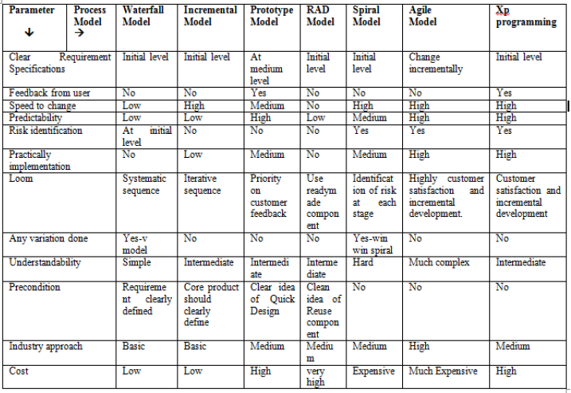
Comparison of Various Process Models using Different Parameters

Slide 20
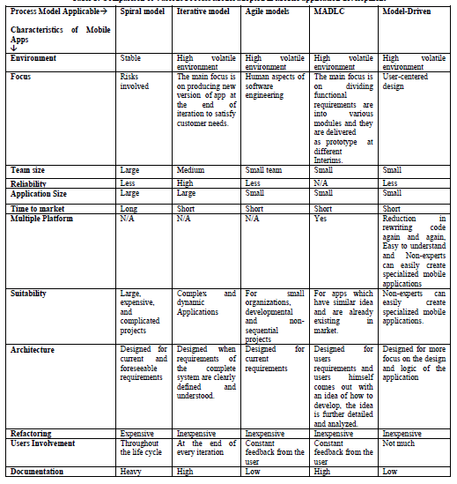
Comparison of Various Process Models Adopted in Mobile Application Development

Slide 21
Comparison of Various Process Models Adopted in Mobile Application Development
[Ref: Kulwant Kaur, Anureet Kaur, “Suitability of existing Software development Life Cycle (SDLC) in context of Mobile Application Development Life Cycle (MADLC)” International Journal of Computer Applications (0975 – 8887), Volume 116 – No. 19, April 2015]

Slide 22
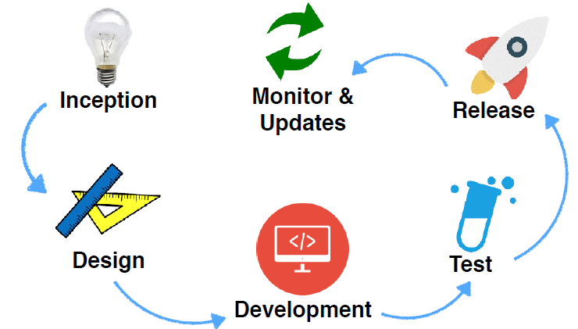
Mobile Application Development Life Cycle
These Phases can be Used with Different Methodologies

Slide 23
INCEPTION
ALL APPS START WITH AN IDEA
Some Questions to consider:
Are there similar apps?
How does this app differentiate from others?
What value does this app bring to users?
How will users use it?
How will this app work in a mobile form factor?
How can I add value using mobile technologies such as location awareness, camera, etc.?

Slide 24
  Why Analysis and Design is important?
  Why Design and Analysis is important?

Slide 25
  YOU CAN NOT
  CONSTRUCT
  MANUFACTURE
  OR
  DEVELOP
  AN ENGINEERING SOLUTION
  ON
  TRIAL AND ERROR BASIS

Slide 26
DESIGN
User Interface and Responsiveness are critical parameters!
User Experience (UX) Design
User Interface (UI) Design
How to start?

Slide 27
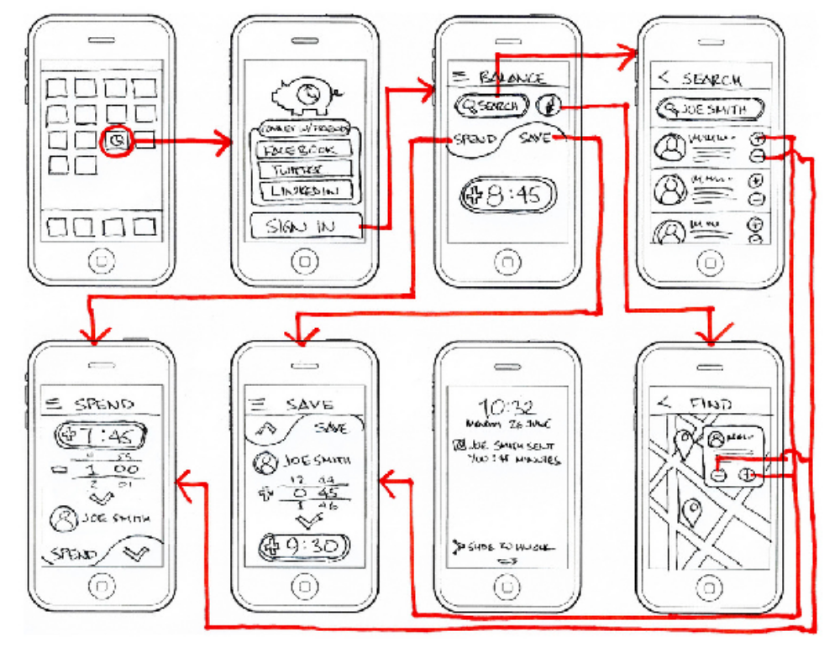
DESIGN
Wire Framing: High-level flow of the app screens

Slide 28
DESIGN
How to create wireframes?
Pencil and Paper
Tools
  Mock flow
  Mocking Bird
  Visio
Mobile User Constraints must be respected while designing the APP

Slide 29
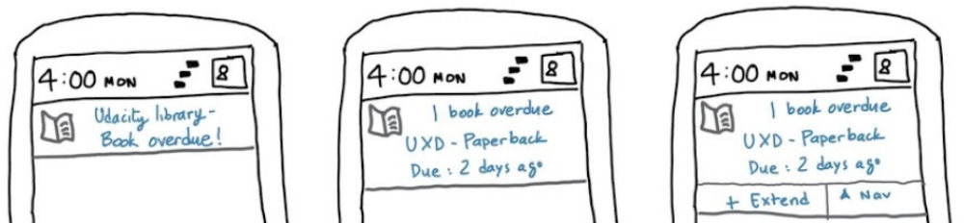


DESIGN
Some Mobile User Constraints Examples:
Respecting Divided Attention
Which is the best way to notify?

Slide 30
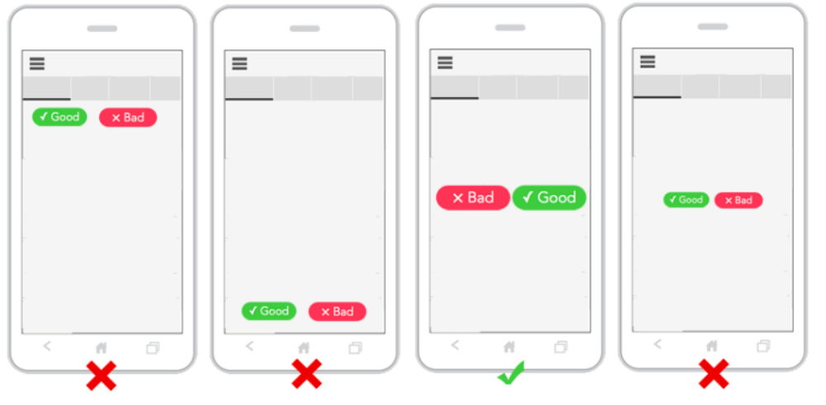
DESIGN
Some Mobile User Constraints Examples:
Handedness
Which is the best screen when user uses the mobile screen?

Slide 31
DESIGN
Some Mobile User Constraints Examples:
Handedness
Which is the best screen when user uses the mobile screen?
RESPECT OW ZONE

Slide 32
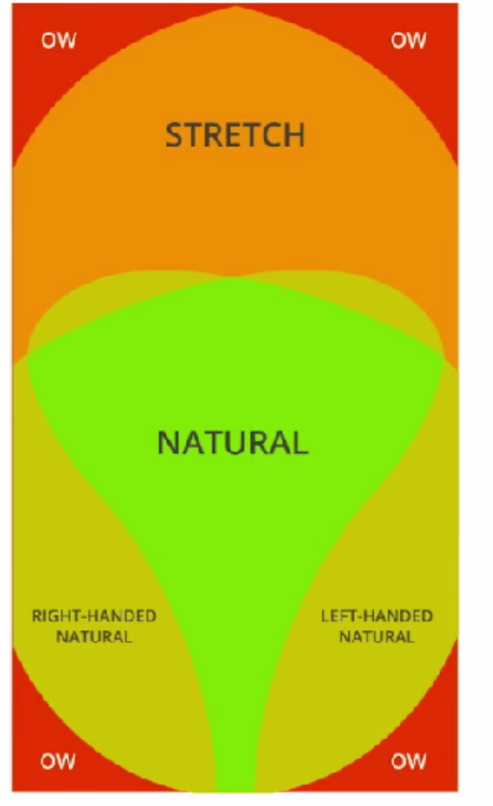

Slide 33
DESIGN
Some Mobile User Constraints Examples:
Small Screens:
  • Don’t overwhelm the user with much information
  • Split screens
  • Images over text
Unreliable Networks
  • Assume that communications will often fail
  • Recover automatically
  • Defensive design for a good user experience

Slide 34
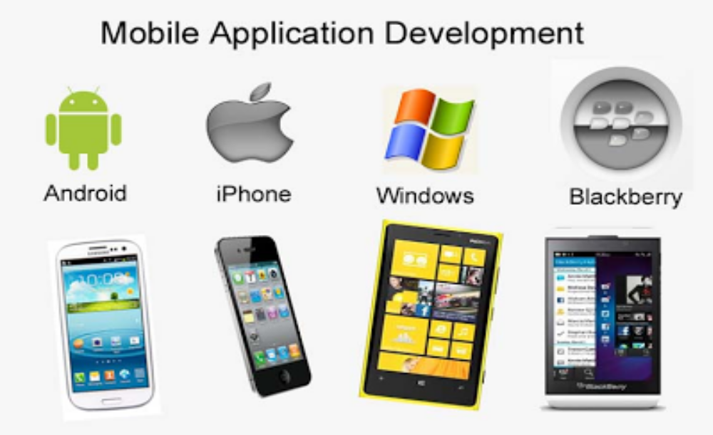
DEVELOPMENT
Which Platform?
Which Platform has more Users?
Which platform has more competitors?
Which platform is more expensive to develop for?
Which platform makes more money for developers?

Slide 35
DEVELOPMENT
Development Tools
Android
  Android Studio
  https://developer.android.com/studio/index.html
iPhone
  Apple Developer SDK and Tools
  http://developer.apple.com
Windows Phone
  Visual Studio IDE and Phone SDK
  http://developer.windowsphone.com
Blackberry
  http://developer.blackberry.com/blackberry_world/

Slide 36
DEVELOPMENT
Cross Platform Development
Target multiple platforms with one code base
  Hybrid HTML5 web app that executes within wrapper in devices
    e.g: Apache Cordova
  SDK that exposes the native APIs for multiple platforms, using a single programming language
    e.g: Xamarin with C#
  Others
    React Native
    Flutter
    Adobe phone gap etc.

Slide 37
TESTING
“Apps that receive negative user feedback in the first release, never become popular afterwards”
Verify correctness, functional behavior and usability before releasing app publicly.
Testing Challenge:
  Device Fragmentation
    Brand Fragmentation
    Android OS Fragmentation
  Screen Fragmentation
  Heterogeneous Contexts
    Networks
    Locations
How to simulate real conditions in lab?

Slide 38
TESTING
Types of Testing:
Black-box Testing. Check the result. Don’t look what happens inside a function.
White-box Testing. Check which code is executed.
Unit Testing. Test individual functions (code).
Functional UI Testing. Checks if the app behaves as expected when UI interactions happens.
Performance Testing. Checks the performance of the app (memory, responsiveness, UI rendering, etc.)
Security Testing. Checks security vulnerabilities and user privacy violations.
Regression Testing. Compare with previous app versions.

Slide 39
TESTING
What to Test?
Key functionality
Key use cases
UI interactions
Sensor data
Phone interactions What happens if there is an input call? A message?
Change in orientation Is the screen re-drawn correctly? Does the app maintain its state?
Change in configuration e.g., Changes in system language, keyboard availability, etc.
Battery life
  Write app to minimize battery usage
  Test methods that manage battery usage
Dependence on external resources
  What happens when the network/Bluetooth/GPS are unavailable?

Slide 40
TESTING
UI Performance Testing
  Mobile apps should run a 60 fps (frames per second)
  Frames taking more time are skipped! (janky app perceived by users)
Testing can be done using:
  Real devices
  Emulators
Emulators are useful but cannot substitute real devices!
Testing on Multiple Devices
  Due to fragmentation, testing on multiple devices is necessary only one devices is not enough

Slide 41
RELEASE
Distribution
  Publish the app!
Prepare the app for release
  What needs to get deployed with the app? Executable, images, database, libraries ?
  Constraints (app runs on specific devices?)
  Versioning
Release the app to users
  Typically through App Marketplaces, e.g., Google Play Store, Apple App Store, etc.
  Own distribution channels, e.g., website

Slide 42
RELEASE
  Release APP Progressively!
Release progressively to ensure a positive reception Alpha- and Beta- Testing
Release early version of the app with a subset of users
Fix technical or user experience issues before releasing the app widely
Also release updates progressively

Slide 43
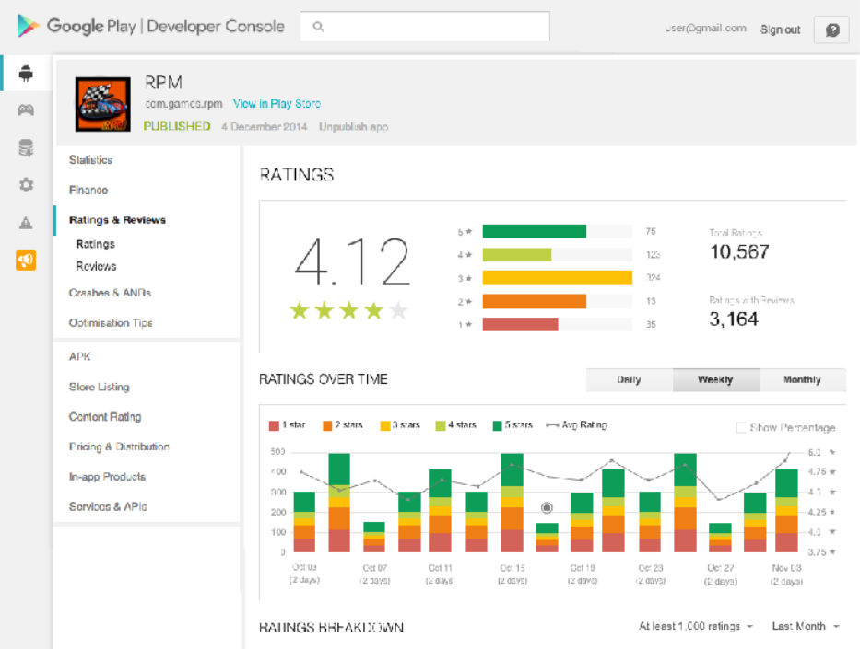
MONITOR AND UPDATTE
Gather and process data about the app to identify how the app is performing
  Review information about the app: installs, ratings, crashes…
  Changes in the app’s performance can indicate good and bad things
Quickly identify and correct issues before they massively affect users’ experience and harm app reputation
Google Play Developer Console
Monitor User Reviews
  Keep an eye on users’ reviews!
    User reviews contain valuable
    feedback and suggestions for
    improving the app
    Read and reply to user reviews
      • Improve users' loyalty!

Slide 44
MONITOR AND UPDATTE
Crash Reports:
  App crashes and ANRs (Application Not Responding) heavily disrupts users experience
    Lead to negative reviews and ratings
  Use crash reports to debug and improve your app
  Correct any issues quickly!
  Avoid bad reputation
  Reverse negative reviews

Slide 45
SECURITY
Devices have access to many sensitive information!
  Personal data
    User name, address, id
    Passwords
    Banking data
    Confidential documents
  Sensor data
  GPS location. Track people!
  Camera & Micro. Surveillance!
  Privacy policies
  Security policies
  User agreements

